Slide 1
St. Paul of the Cross retreat Center
Relax. Connect. Pray.
Notes:
Relax. Connect. Pray.

Slide 2
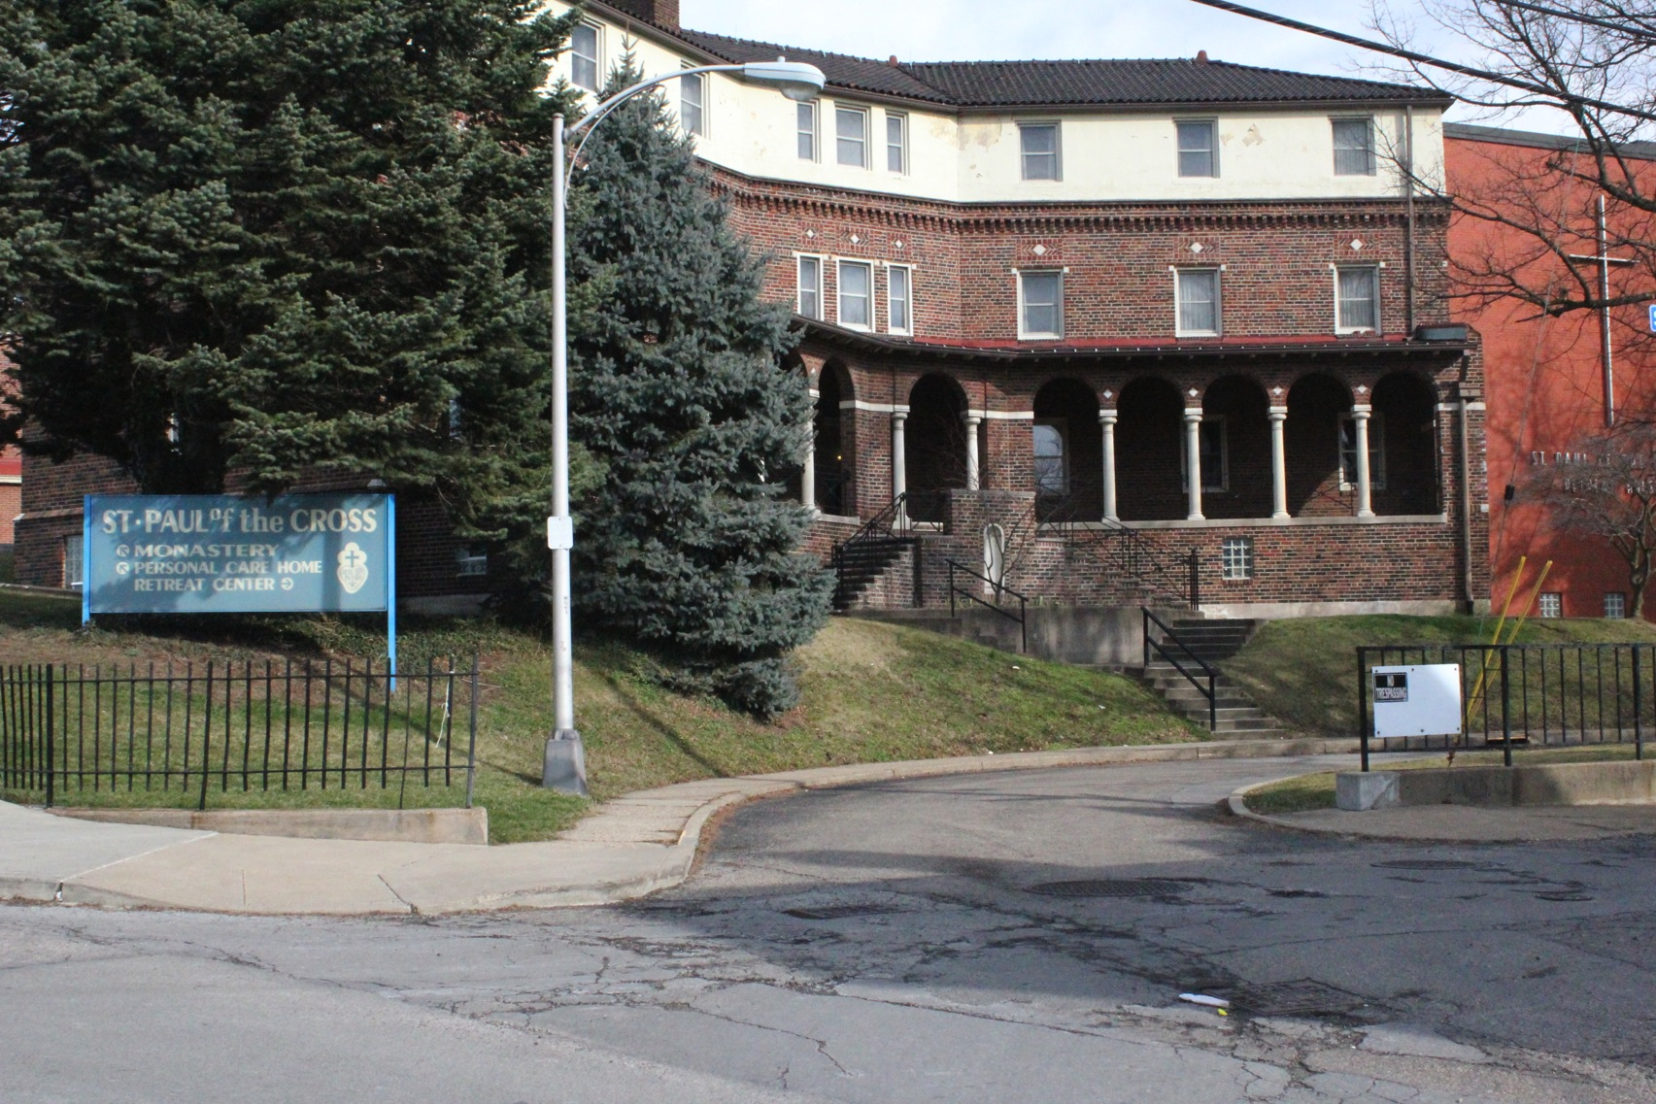
Notes:
Entrance to Original Retreat Center

Slide 3
Notes:
New Retreat Center

Slide 4
Notes:
Driveway to St Paul of the Cross Retreat Center

Slide 5
Notes:
Entrance to the Retreat House

Slide 6
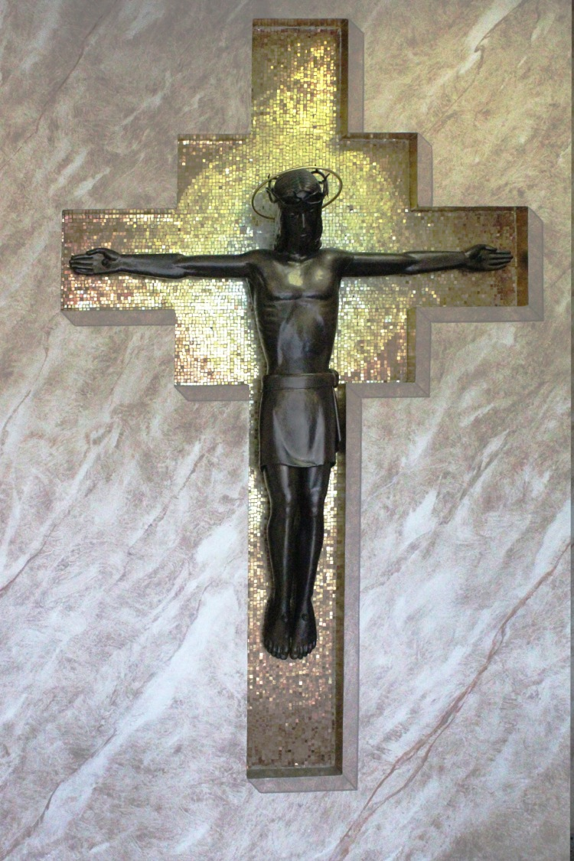
Notes:
Welcome!

Slide 7
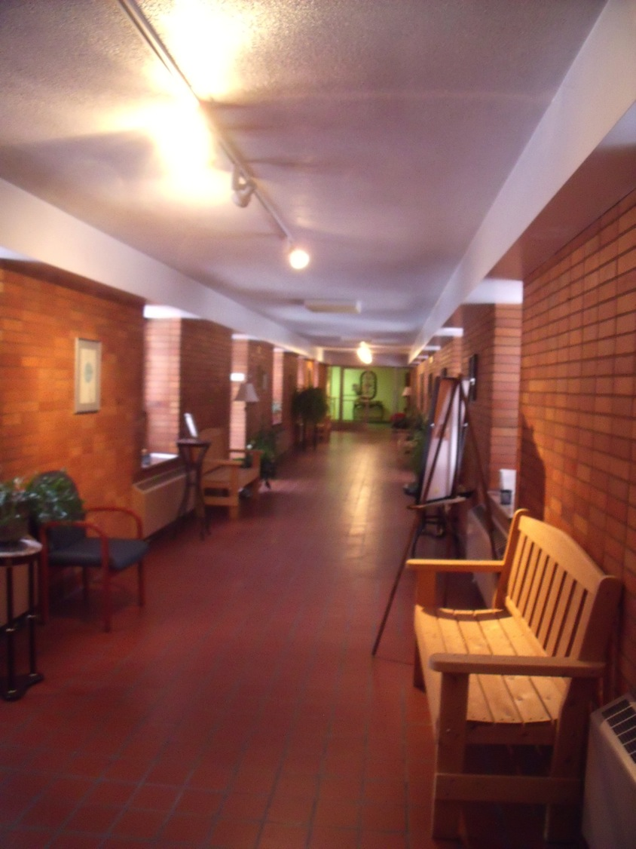
Notes:
Cloistered walkway

Slide 8
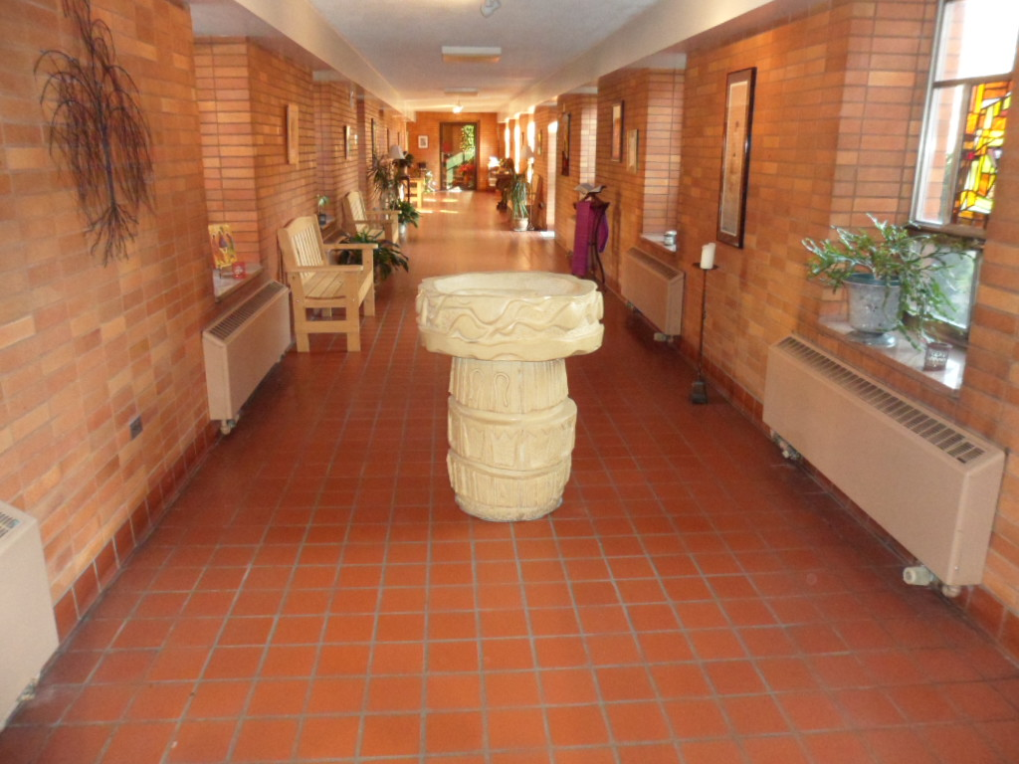
Notes:
Cloistered walkway leads to the C hapel

Slide 9
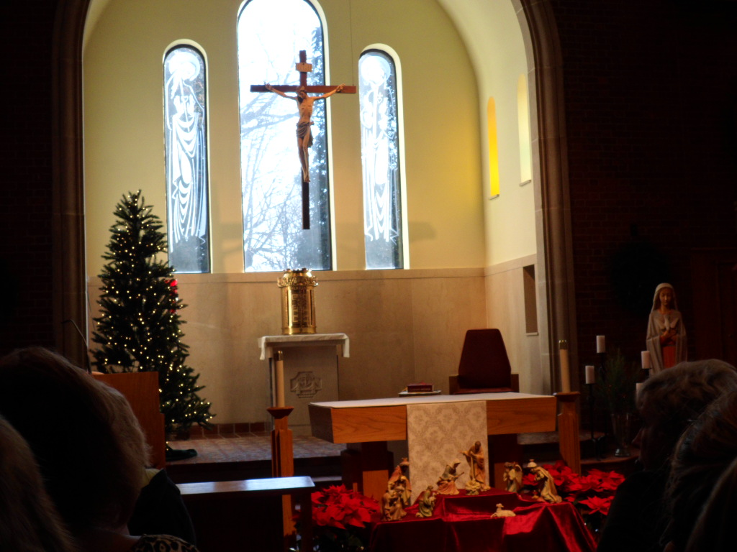
Notes:
Christmas at St Paul of the Cross Retreat Center

Slide 10
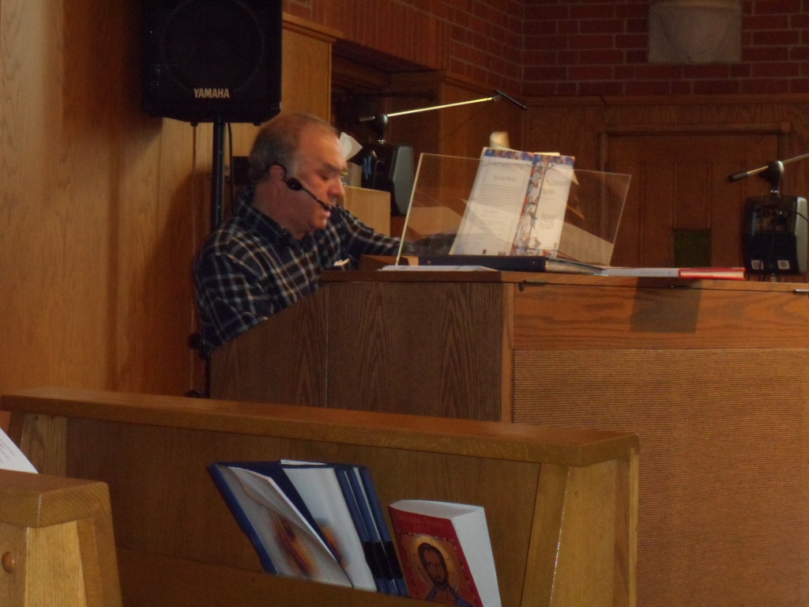
Notes:
Music Director-Mr. Henry Caruso

Slide 11
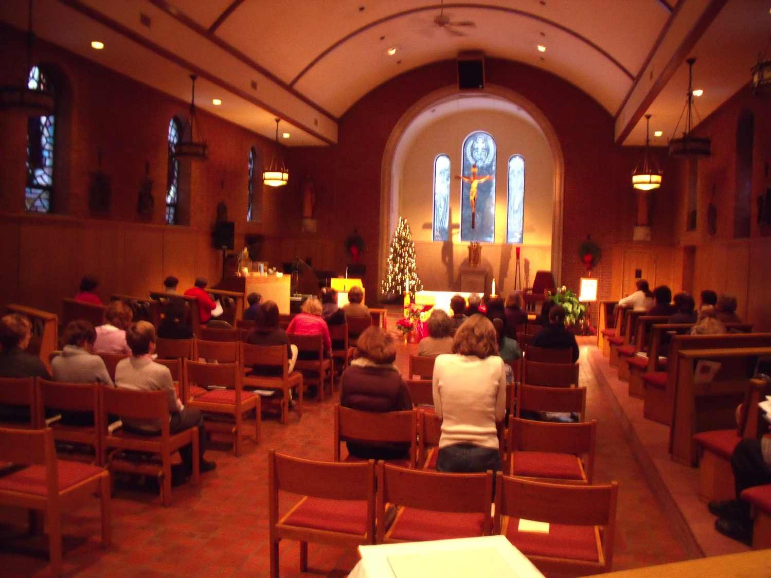
Notes:
Mass in the Chapel

Slide 12
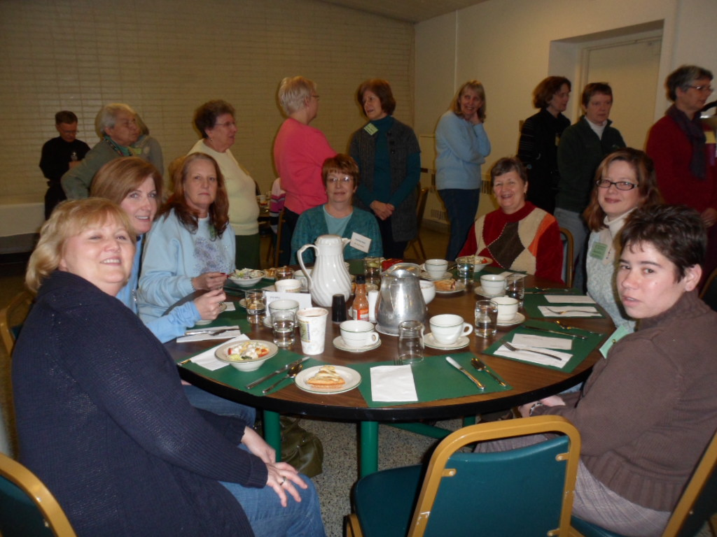
Notes:
Dinner in the Retreat Center dining room

Slide 13
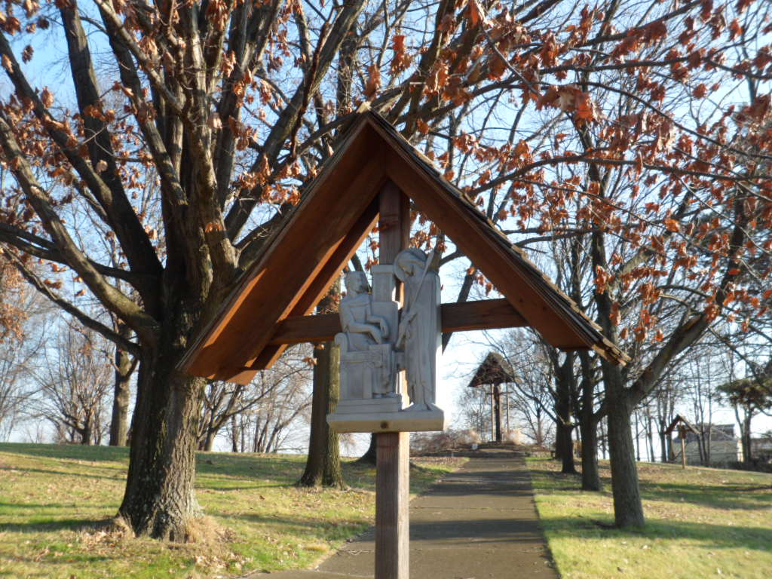
Notes:
Stations of the Cross in the walking gardens

Slide 14
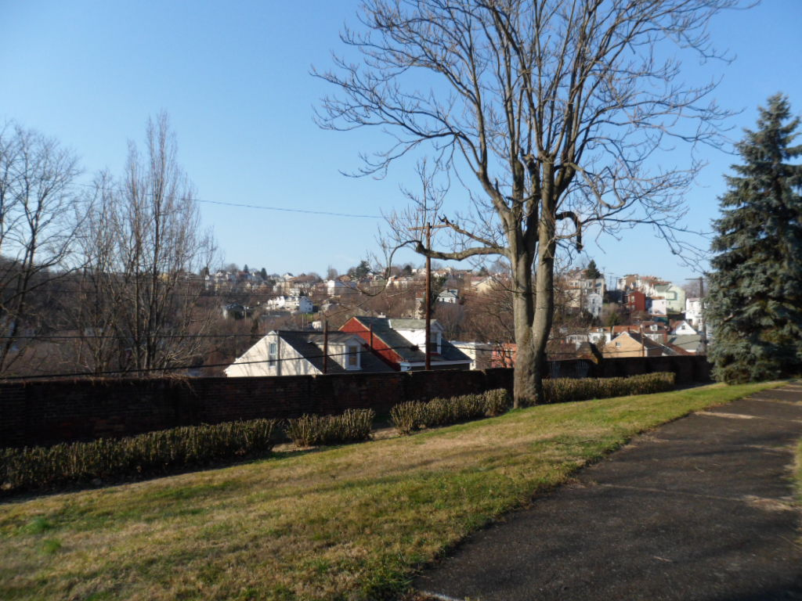
Notes:
Beautiful private, walking gardens

Slide 15
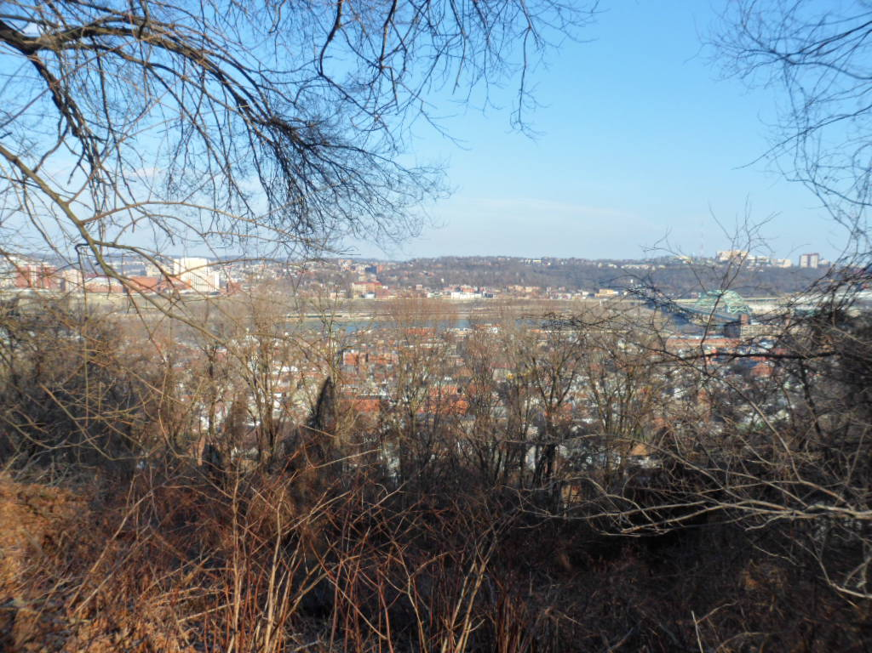
Notes:
View from the gardens overlooking Pittsburgh

Slide 16
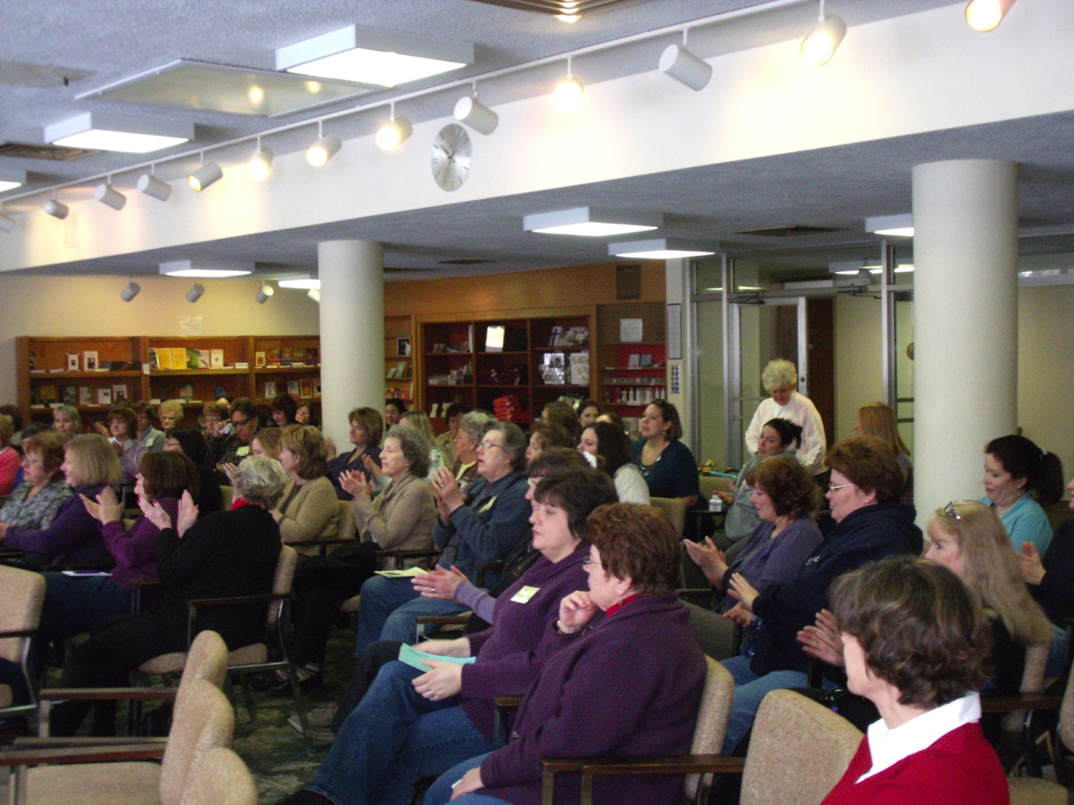
Notes:
Retreat program in the very comfortable Main Lounge

Slide 17
What are the rooms like?
Notes:
Clean and comfortable bedrooms

Slide 18
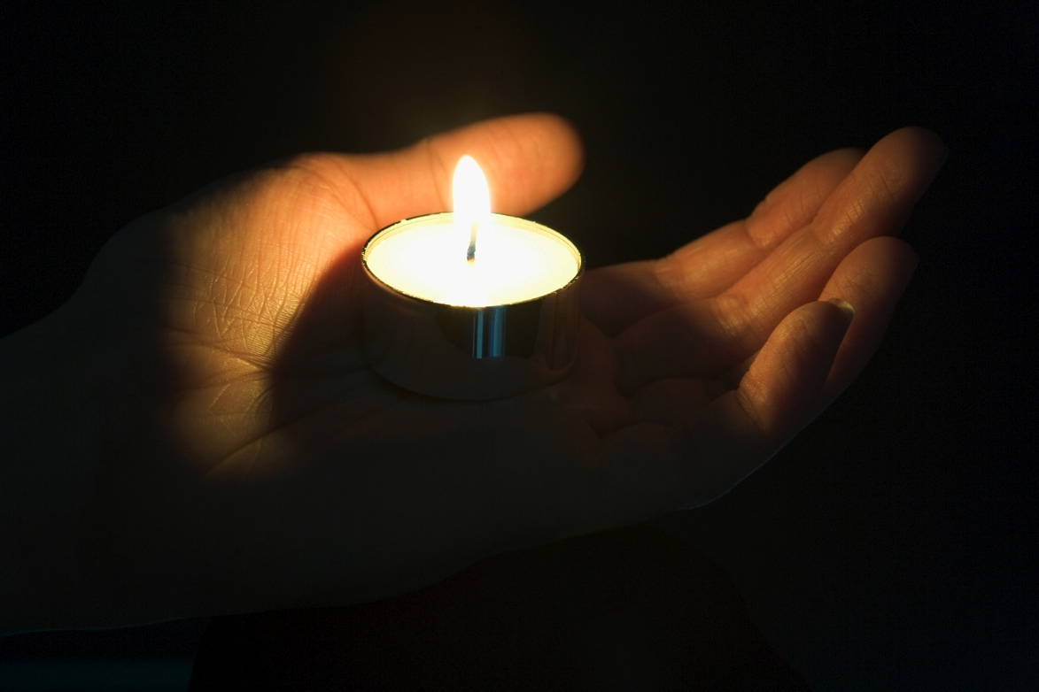
Come Join Us.
Make The Time (For Yourself)
Relax Reflect Reconnect
Notes:
2014 Retreat

